Slide 1

Public Humanities
Issues in Digital Humanities
Ruth Davy

Slide 2
Public Humanities
Introduction
Explore the definition of the public humanities
Look at the intersection with public humanities and digital humanities
Explore Challenges and opportunities presented by public humanities
Personal Attacks & Trolls
Public Perception & Education
Intellectual Property & Ownership
Anonymity & Authority
Inclusion & Access
FUTURE OF DIGITAL PUBLIC HUMANITIES

Slide 3
What comes to mind?
Public

Slide 4
What comes to mind?
Public
Humanities

Slide 5
Key Components of Existing Definitions
Public humanities is
the work of federal, state, nonprofit and community-based cultural organizations;
OPEN the humanities to the public;
ENGAGE public in conversations/programs on humanities & relevance to current life.

Slide 6
How does this relate to our overall discussion of the digital humanities?
Digital
Traditional

Slide 7
Public Scholarly Discussions
Challenges
Opportunities
Expectation placed on academics to participate
Opposition to popular viewpoints expressed in public sphere
Risk adverse institutions
‘outrage machine’
Challenge unpopular ideas/popular ideas
Speed of publication can jump t conclusions rather than thought through ideas
Owned/promoted by data brokers
Diversity of voices
Critical thinking
Increased accessibility
Ability to challenged popular/unpopular ideas
Exposure for new authors/scholars

Slide 8

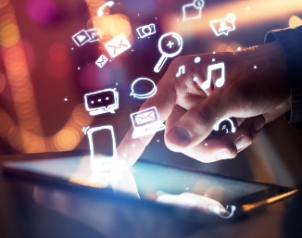

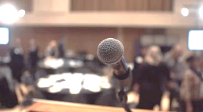

Public Scholarly Discussions
Challenges
Opportunities
Personal Attacks
& Trolls
Public Perception
& Education
Intellectual Property
& Ownership
Authority
& Anonymity
Inclusivity
& Access

Slide 9



Intellectual Property
& Ownership
Animosity on the internet is not a new concept, this week we explored a number of articles chronicling negative reactions to publicly released projects and thought. These examples highlight different prejudices and forms of harassment enabled by engaging the public in discourse.
It may not be safe for everyone to participate actively or openly in the current online environment. How can this be mitigated? Should we discourage this kind of discussion online?
Personal Attacks
& Trolls
Authority
& Anonymity
Public Perception
& Education
Inclusivity
& Access

Slide 10
Intellectual Property
& Ownership
What about the creation of ‘safe spaces’ with a registration wall to participation (such as DH slack) where like-minded individuals come together with a collective etiquette for participation? What are the drawbacks to this approach? Benefits?
Would a digital etiquette shift be possible? How does this differ from an in-person setting?
Personal Attacks
& Trolls
Authority
& Anonymity
Public Perception
& Education
Inclusivity
& Access

Slide 11
Intellectual Property
& Ownership
In the articles this week about Sarah Bond’s experience, in addition to the personal attacks that she experienced, the issue of public perception and changing a narrative around certain humanities disciplines is also discussed.
What role can the digital humanities take in informing cultural sector productions and education to accurately portray history and human civilizations?
Is the creation of these works a piece of public humanities, in that it engages the public with aspects of the discipline?
Personal Attacks
& Trolls
Authority
& Anonymity
Public Perception
& Education
Inclusivity
& Access

Slide 12

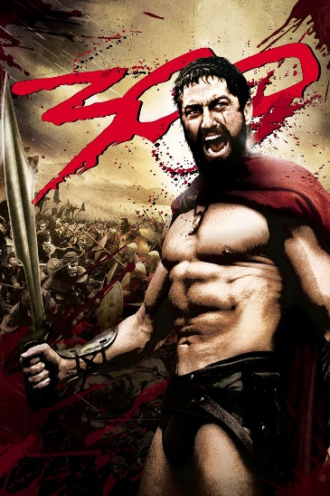
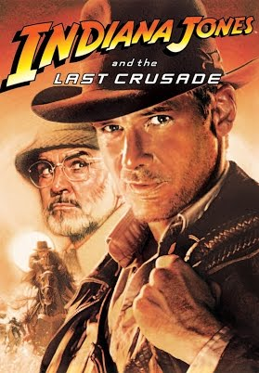
Intellectual Property
& Ownership
In the art of storytelling, how much responsibility does the author/creator have in creating something accurate?
Can the audience differentiate? What did they get right? What did they get wrong? Does it matter?
Personal Attacks
& Trolls
Authority
& Anonymity
Public Perception
& Education
Inclusivity
& Access
Photos from IMDB

Slide 13
Intellectual Property
& Ownership
Who owns the intellectual property derived from public conversations? Who funds the underlying work product?
In order to continue an academic career, is there an expectation to foster an online brand? Why?
How does the pressure to engage the public in activities impact what is being studied and the methods for these studies? What impact does this have on projects?
Personal Attacks
& Trolls
Authority
& Anonymity
Public Perception
& Education
Inclusivity
& Access

Slide 14
Intellectual Property
& Ownership
We’ve already discussed the impact of anonymity on reactions to public projects. What about authority in the online space?
How does one balance the need for authoritative sources that are well-vetted with a need for some level of anonymity in order to preserve the privacy of the individual?
Personal Attacks
& Trolls
Authority
& Anonymity
Public Perception
& Education
Inclusivity
& Access

Slide 15
Intellectual Property
& Ownership
Are detractors more likely to target a named individual or an anonymous contributor?
Deindividuation is a concept in social psychology that is generally thought of as the loss of self-awareness in groups.
Personal Attacks
& Trolls
Authority
& Anonymity
Public Perception
& Education
Inclusivity
& Access

Slide 16
Intellectual Property
& Ownership
How can digital tools and resources make cultural objects more accessible, engaging, and relevant to the personal and professional lives of various publics?
How do we define the relevant audiences of a project? Is the concept of starting with the audience first through the full design valid?
What kinds of projects require engagement with a community for the duration? Are there any that do not?
Personal Attacks
& Trolls
Authority
& Anonymity
Public Perception
& Education
Inclusivity
& Access

Slide 17
Examples of Digital Public Humanities Projects
Who is the audience? What information are we conveying? What is the objective of the project?
Virtual Museum of Canada - http://www.virtualmuseum.ca/home/
Artefacts Canada - https://app.pch.gc.ca/application/artefacts/index-eng.html
British Museum Collections Online - http://www.britishmuseum.org/research/collection_online/search.aspx
Games for change - http://www.gamesforchange.org/

Slide 18
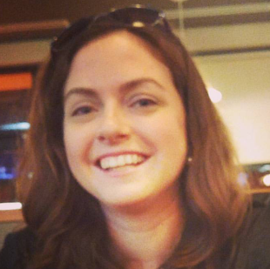
For more information
Ruth Davy
Senior Account Manager, Ipsos Public Affairs
ruth.davy@ipsos.com
613-688-8981

